Slide 1

6th Grade
World History 22-23
Mrs. Lowery

Slide 2
Sixth Grade World History Grading Policies
County-wide Grading Scale in use:
  A = 90% and above
  B = 80%-89%
  C = 70%-79%
  D = 60%-69%
  F = 59% and below
Grade breakdown in World History:
70% Tests/Quizzes/Projects
30% Classwork/Homework/Participation
Tests and Projects = 100 points
Quizzes = 50 points
Assignments = 100 points
Homework
Nightly review of notes, and vocabulary
Make sure Agenda/planner is filled in every week
Binder organization/online grade checks (FOCUS): at least once per week

Slide 3

Positive Reinforcements!
Marble Challenge: Students work together to earn marbles in their period jar. At the end of the 9 weeks, the period that has the most marbles wins a reward day.
Class Dojo: Students work independently to earn Dojo points. Points = Treat Trolley tickets and are redeemable at the end of each month. Be on the lookout for the parent letter that is coming home soon.

Slide 4

Structure of a World History Class
Sixth Grade World History Curriculum
Discovering our Past-A History of the World:
Books remain in the World History classroom
  Vocabulary, notes, study guide, will remain in the binder for the duration of the nine weeks
Lesson discussion (PPP, note sheet)
Assignment (connected to the topic we are studying)
Videos (we watch lots of pieces and parts)

Slide 5
World History Class Routines/Procedures
When a student is absent they should…
  check the “Absent?” folder
If a grade is marked with a Z in Focus
  turn it in if you were absent on the day it was assigned, after being graded the Z will be replaced wit grade earned.
  check the “No Names” file, add your name and turn it in for a grade
The ONLY opportunity for extra credit…
is to complete the Study Guide and turn it on the day of the test(prior to the test…of course).

Slide 6

What Parents Can Do
Encourage your child to read the chapter notes, look over vocabulary (make note cards).
Assist with studying for tests by using the study guides and online resources such as PPP, Quizizz, Kahoot, or Jeopardy game reviews.
Encourage your child to keep an organized binder and check FOCUS at least once a week.
Encourage your child to advocate for him/herself by asking questions and emailing the teacher directly when needed-share the next slide with your student

Slide 7
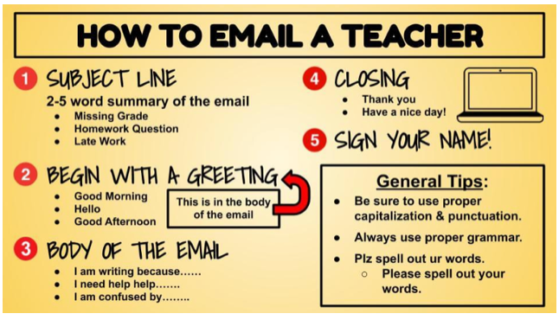
STUDENTS:
ALWAYS INCLUDE:
YOUR FIRST, LAST NAME, AND PERIOD #

Slide 8

Classroom Needs:
*INDEX CARDS- 3’’x5’’-LOTS and LOTS of them!!
*Paper towels
*individually wrapped candy(skittles, lollipops, mints)

Slide 9

It’s going to be a great year. World History is awesome!
If you have any further questions, please contact me at loweryd@leonschools.net. I will only see emails sent via Outlook!! If you send through FOCUS or Canvas, I will not be able to reply.

